Slide 1
PROGRAM : COMPUTER ENGINEERING
SEM : I
YEAR : 1ST
COURSE : ENGINEERING GRAPHICS
COURSE CODE : ENG198904
NAME OF THE FACULTY: SHARYU R. KADAM

Slide 2
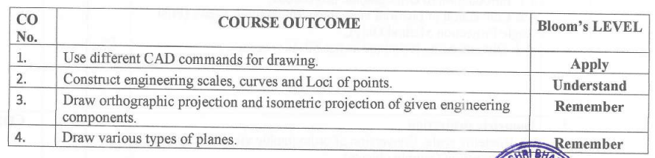
CO’S

Slide 3
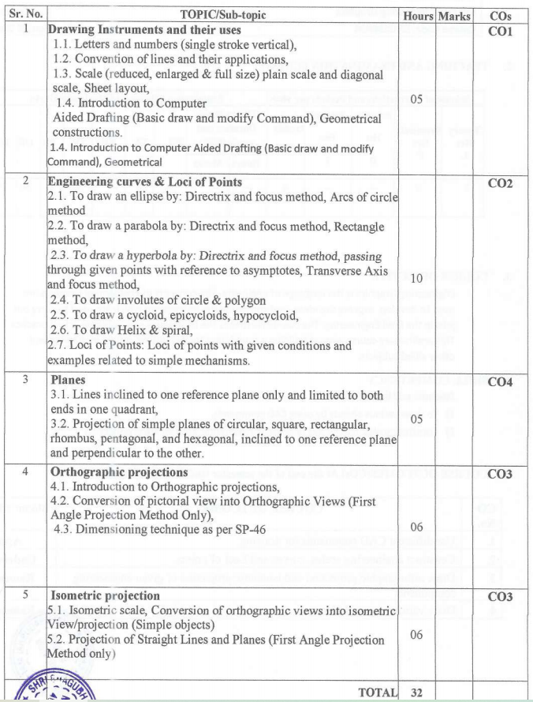

Slide 4
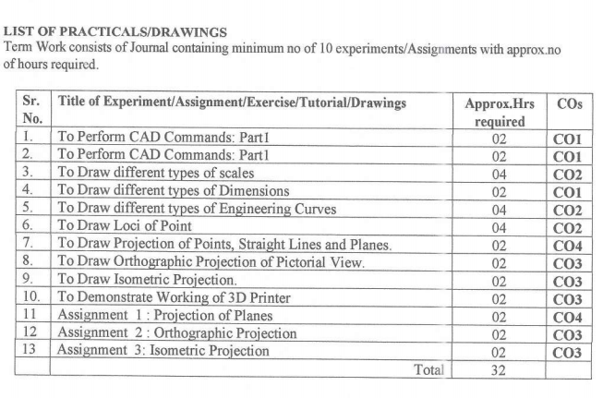

Slide 5
CH- 1 Drawing Instruments and their uses

Slide 6
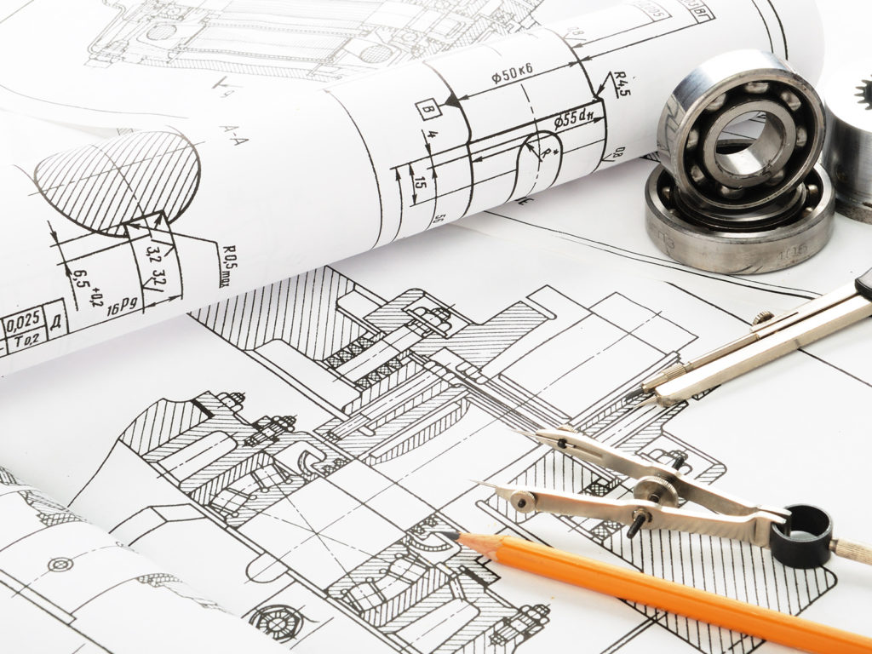
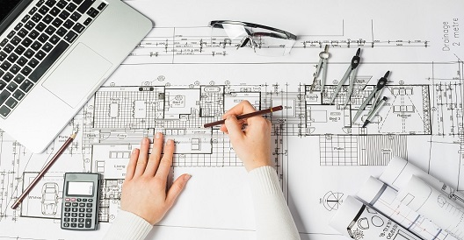
Engineering Drawing
Technical drawing

Slide 7


Engineering Drawing
Graphical Language
Exchange Information

Slide 8
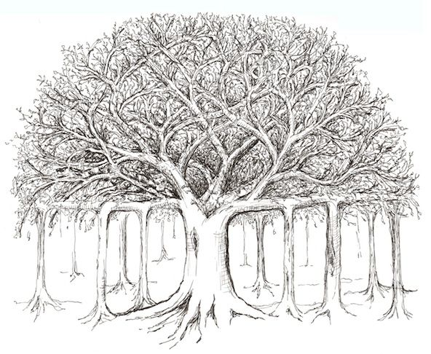
Engineering Drawing
?
Artistic Drawing
Why this banyan tree drawing is not engineering drawing ?

Slide 9
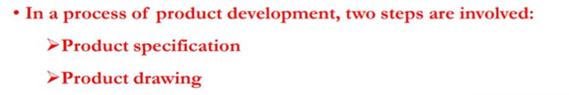
Engineering is the profession in which a knowledge of mathematical and natural science gained by study, experience and practice is applied with judgment to develop product.
Although the works of artists (or photography and other method of reproduction) may provide pictorial representation, but they cannot serve as engineering description.

Slide 10
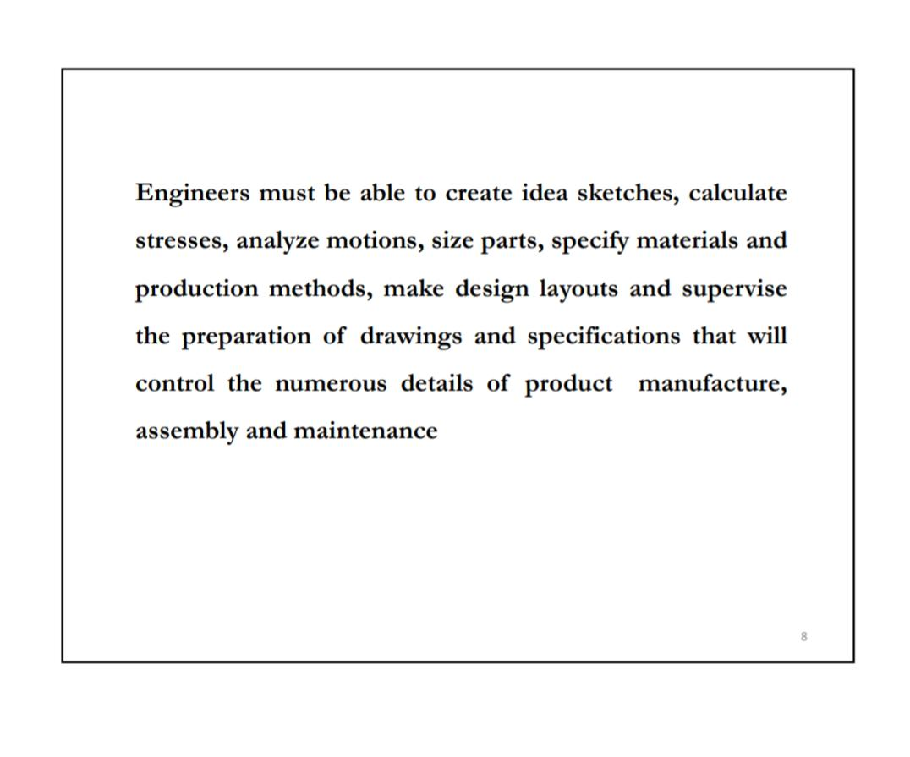

Slide 11
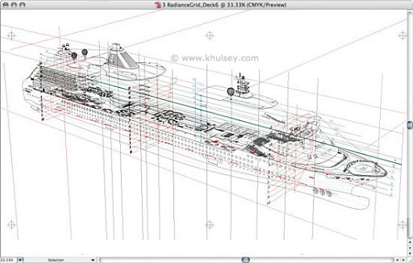
Applications of Engineering Graphics :
Ships

Slide 12
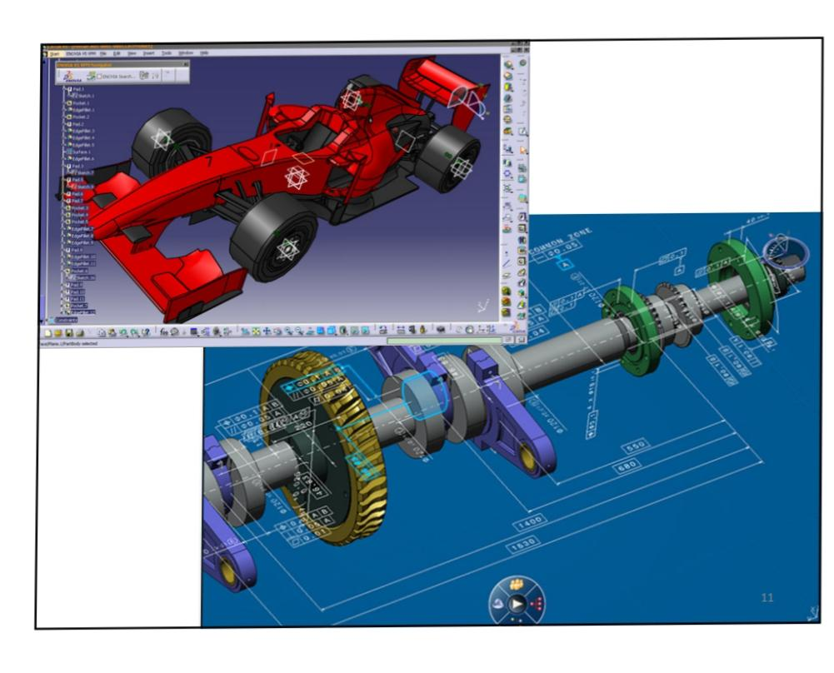
Applications of Engineering Graphics :
Automobiles :

Slide 13
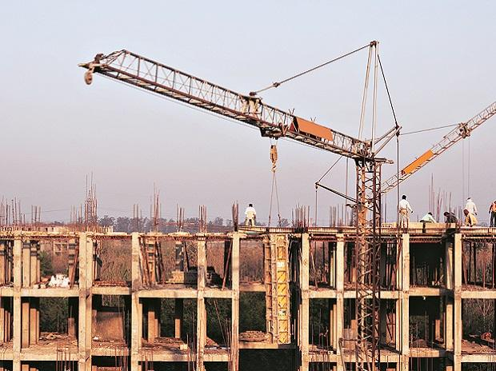
Applications of Engineering Graphics :
Construction :

Slide 14
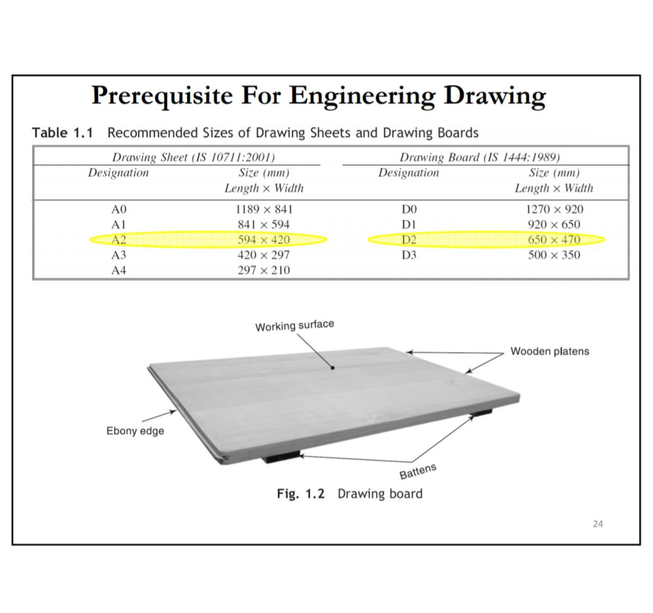
Drawing Board

Slide 15
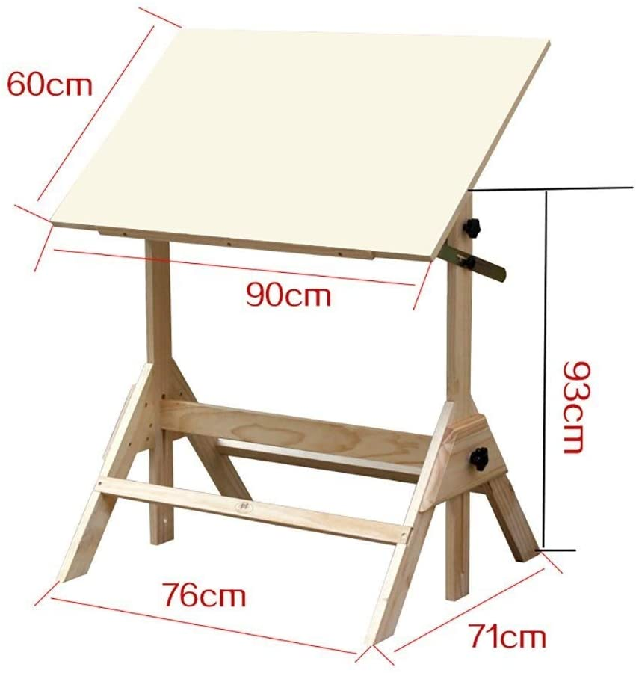

Slide 16
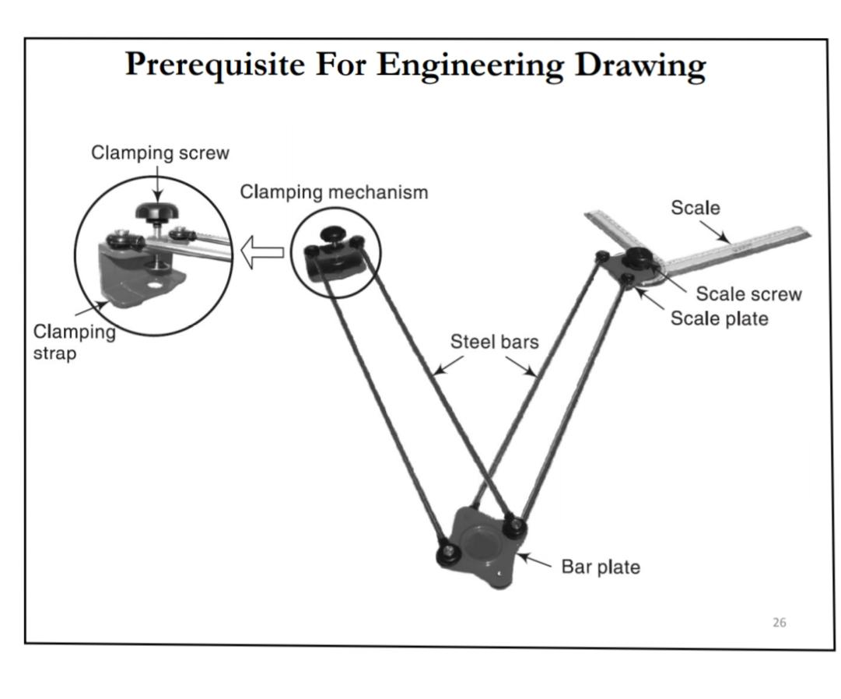
Drafter

Slide 17
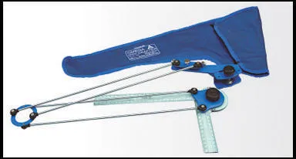
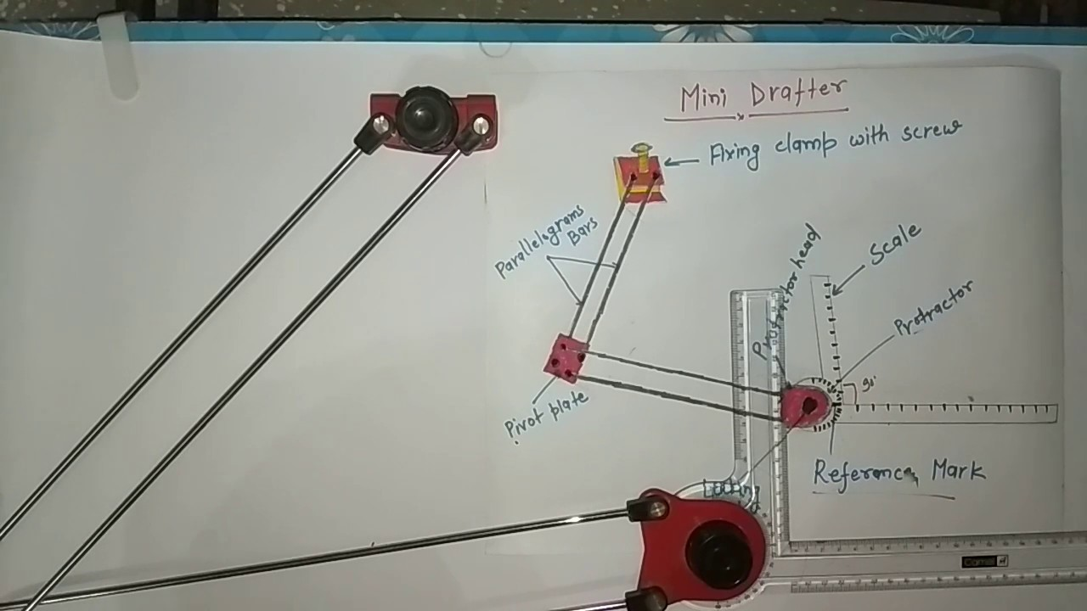
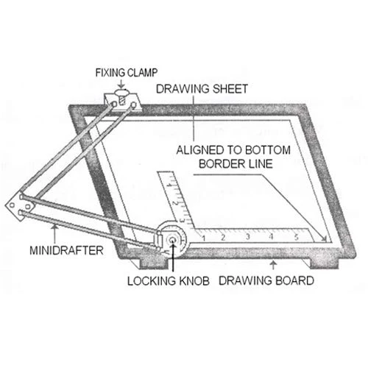

Slide 18
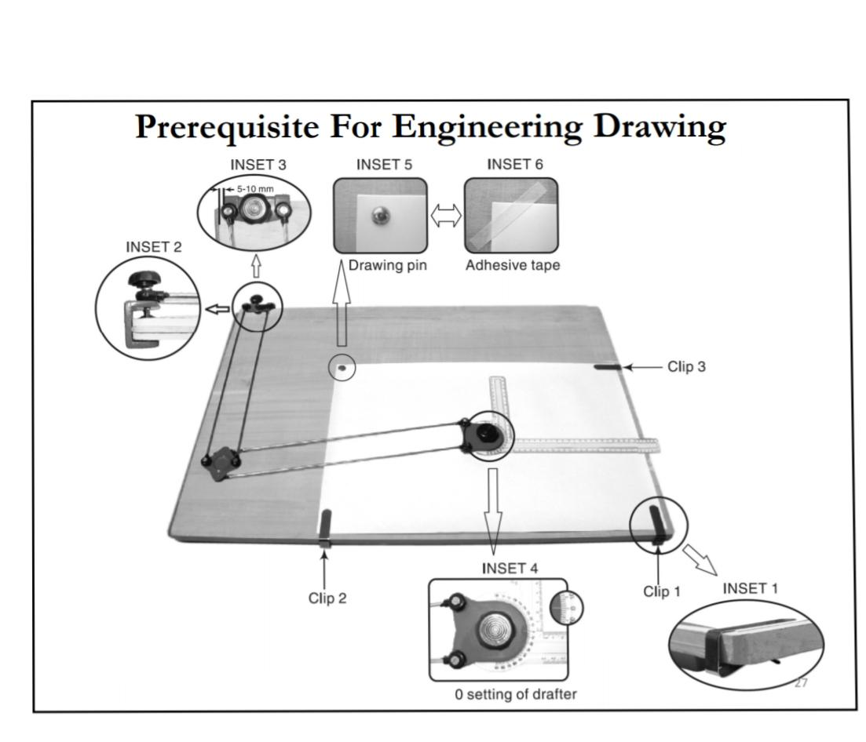

Slide 19
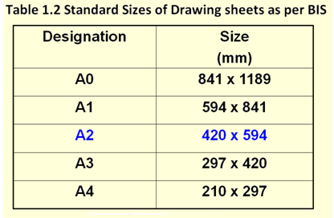
Drawing Sheet

Slide 20
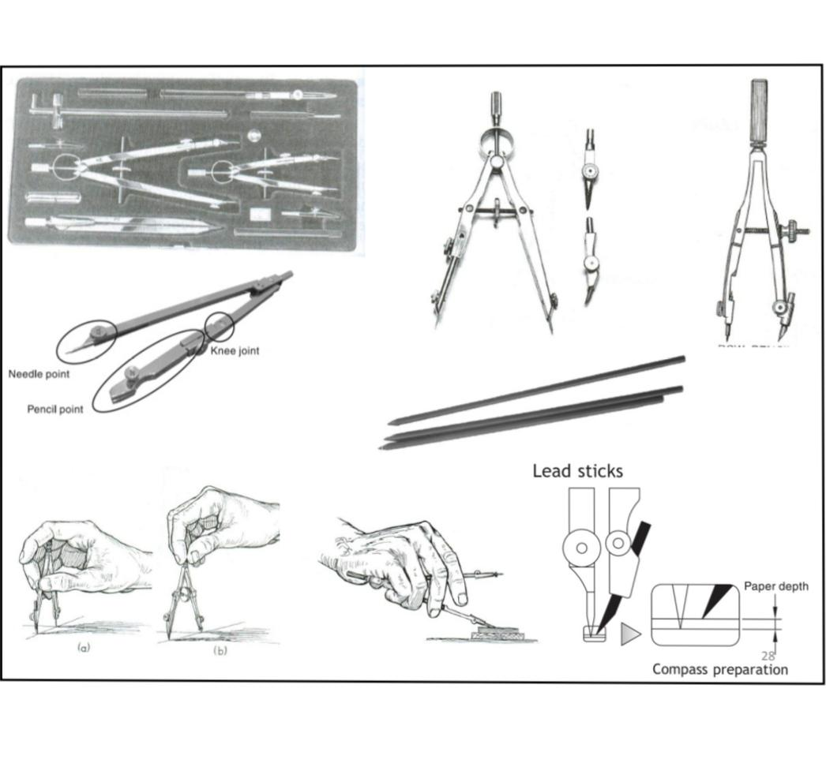

Slide 21
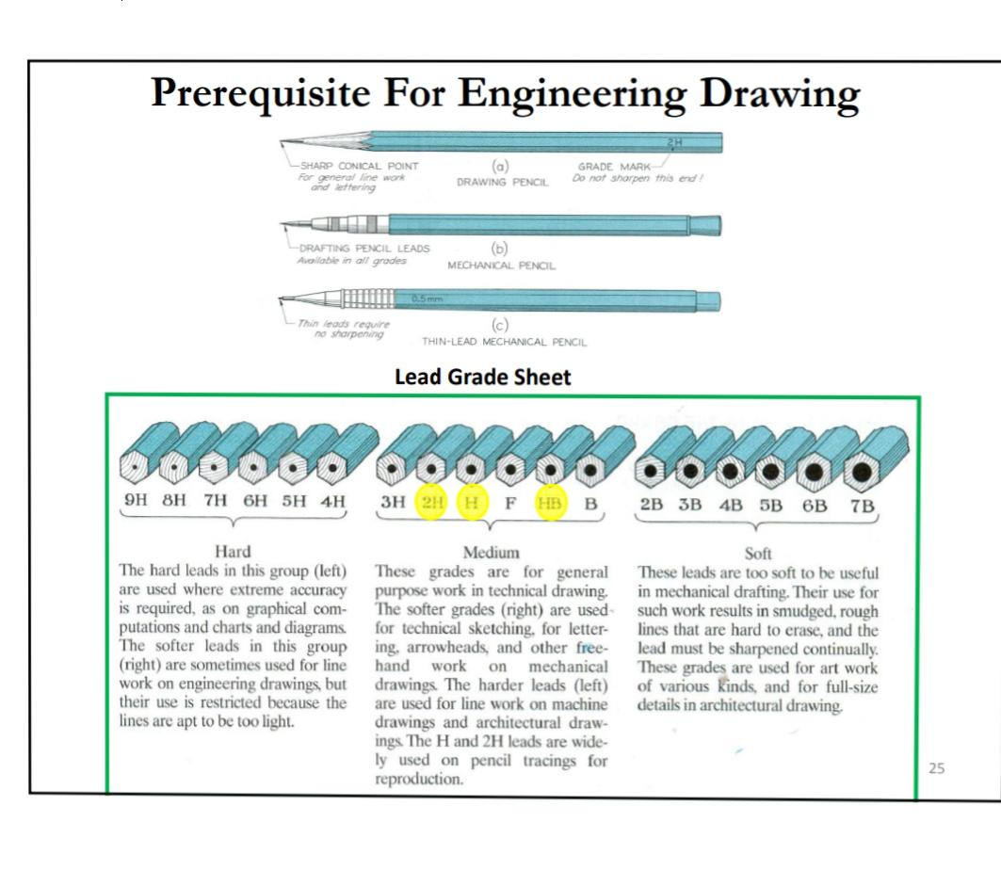

Slide 22
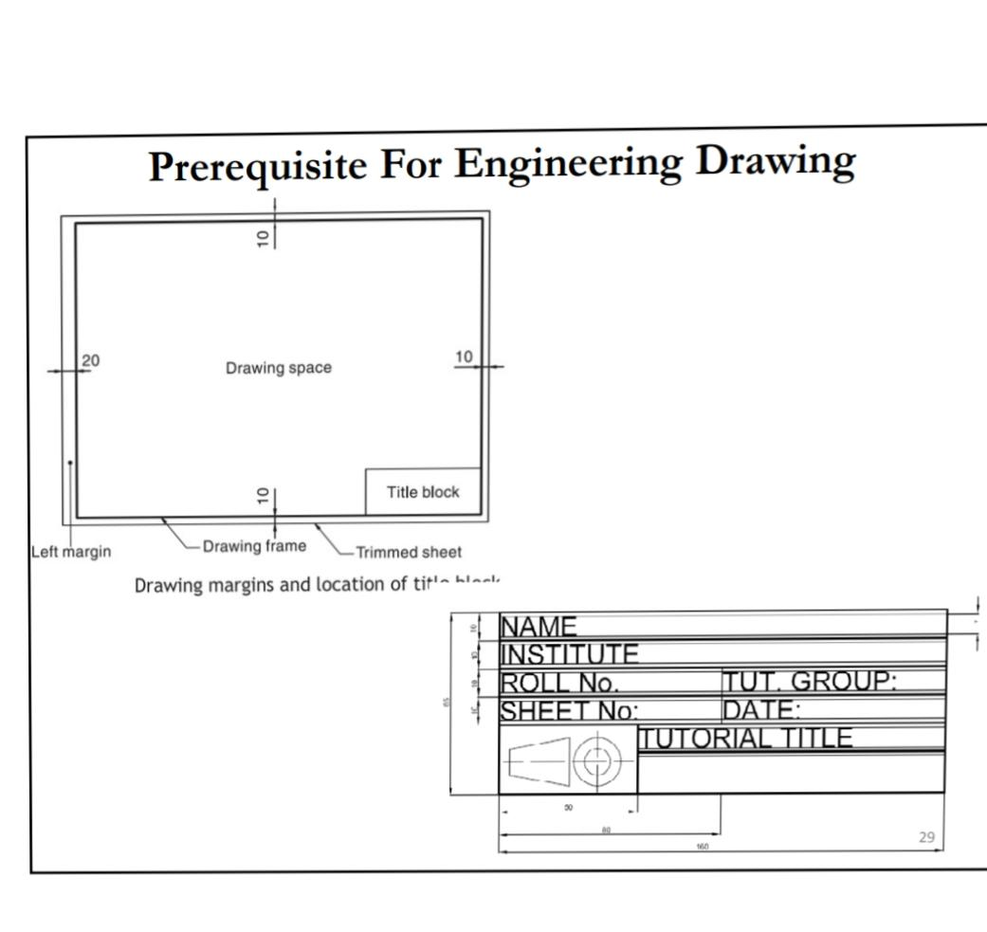

Slide 23
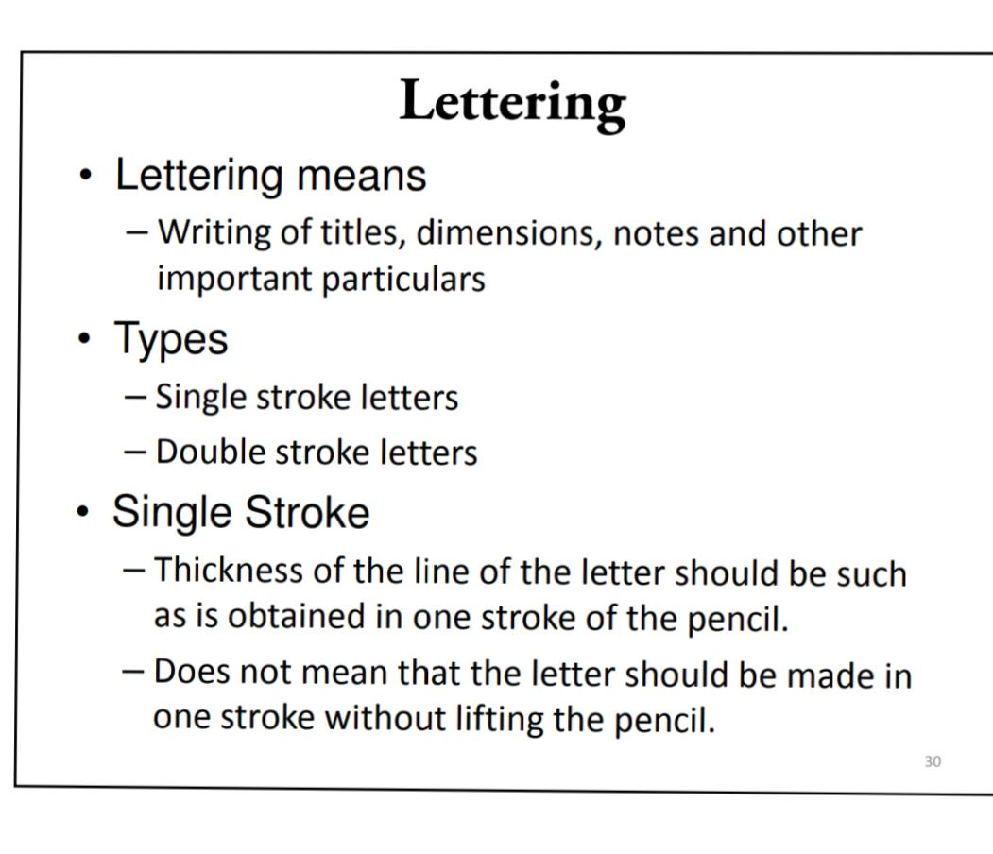

Slide 24
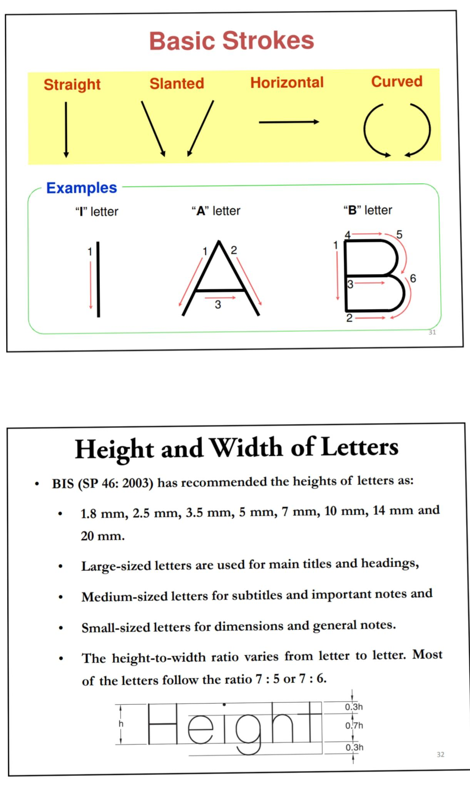

Slide 25
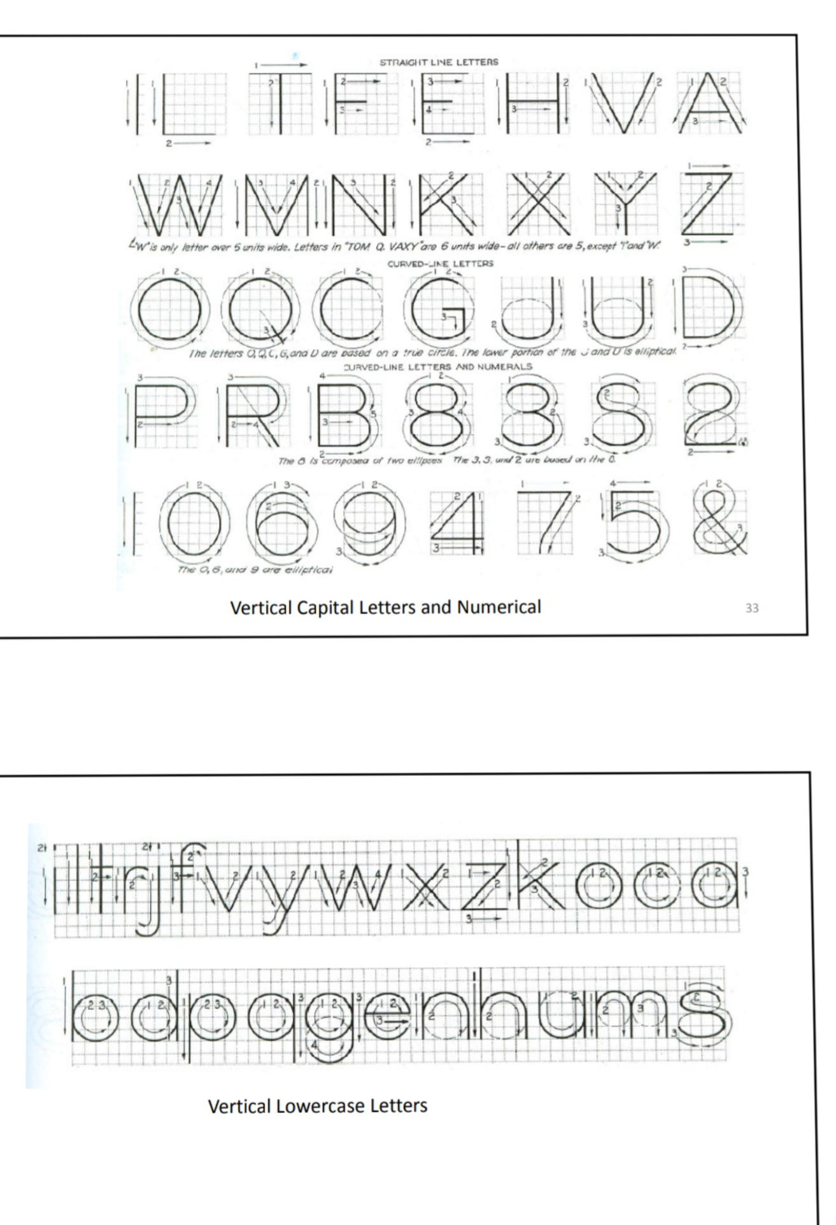
IPv6

Slide 26
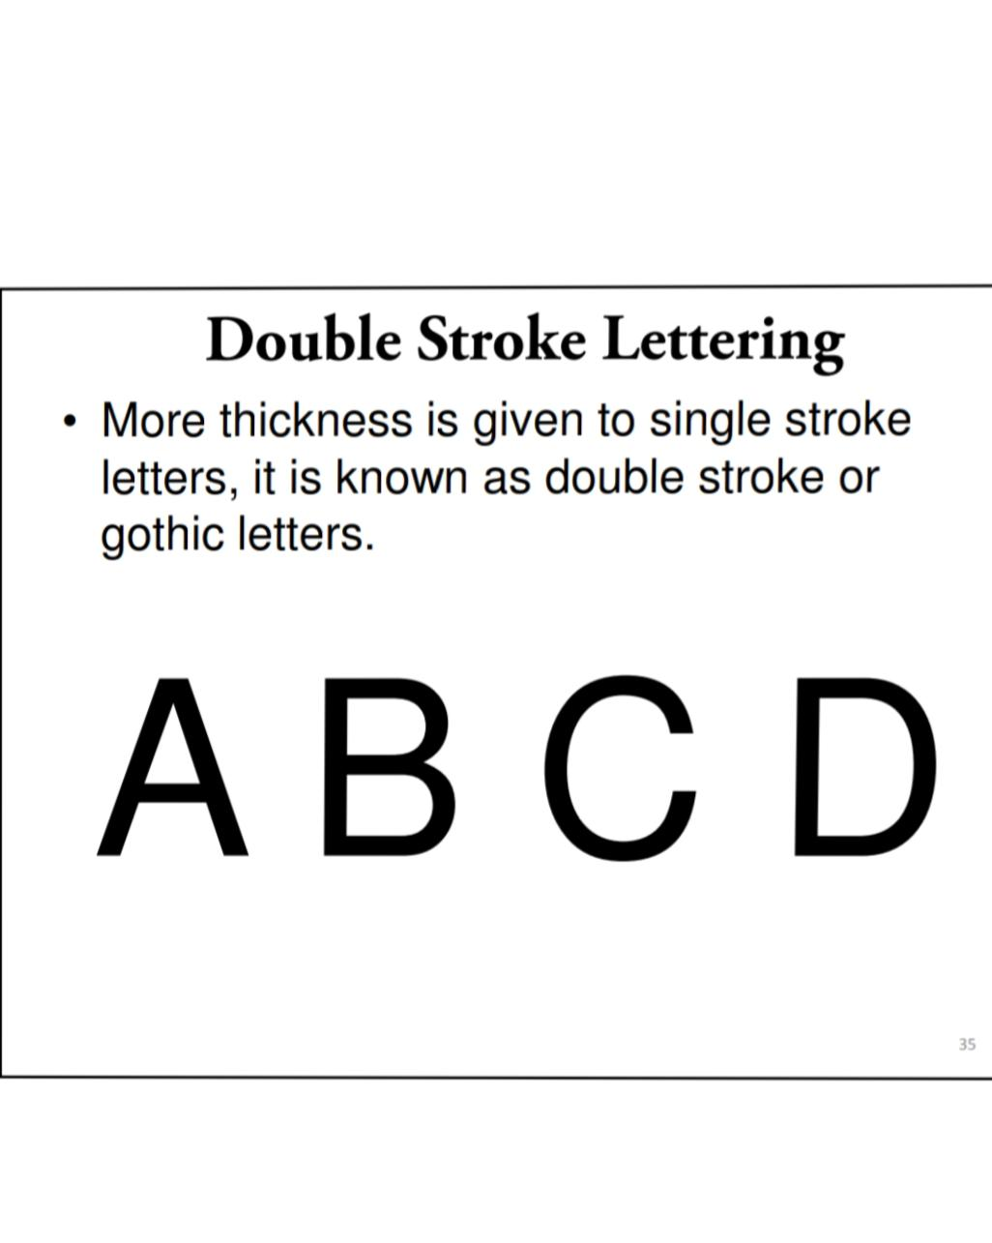

Slide 27
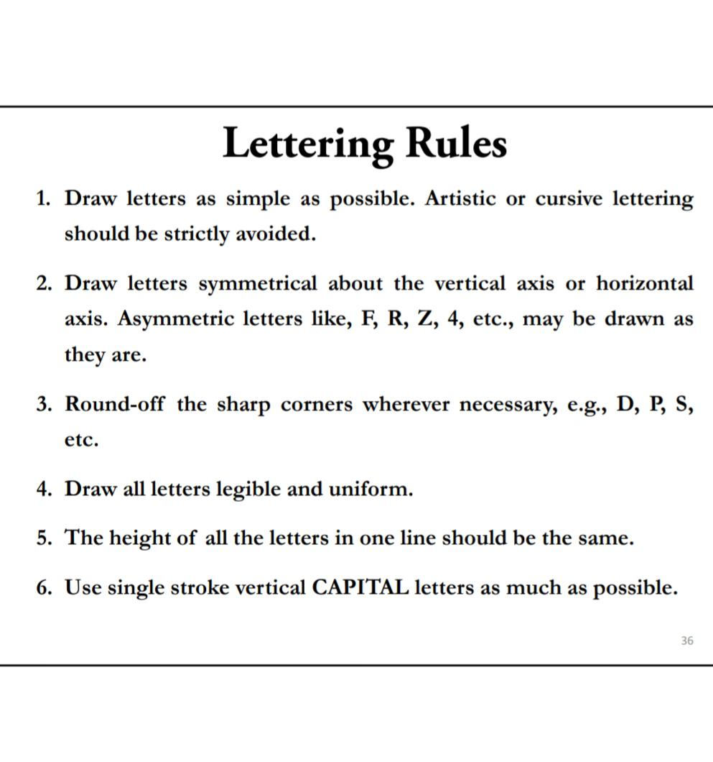
IPv6

Slide 28
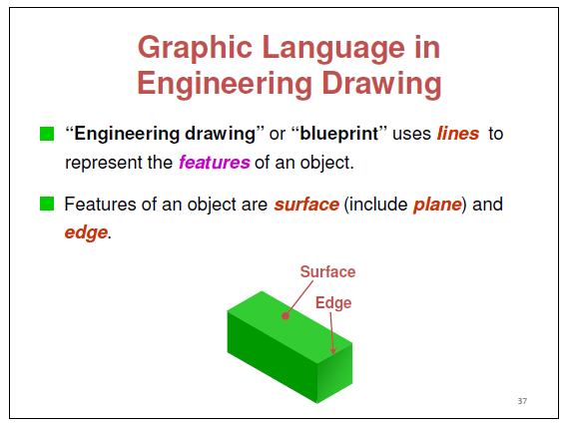

Slide 29
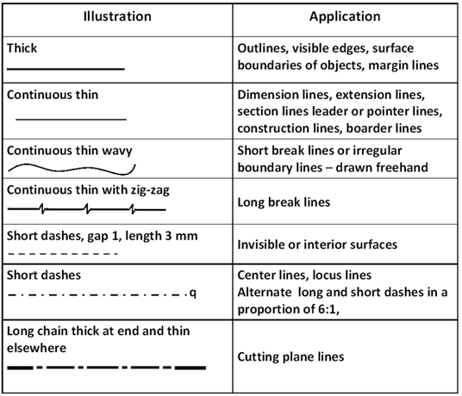

Slide 30
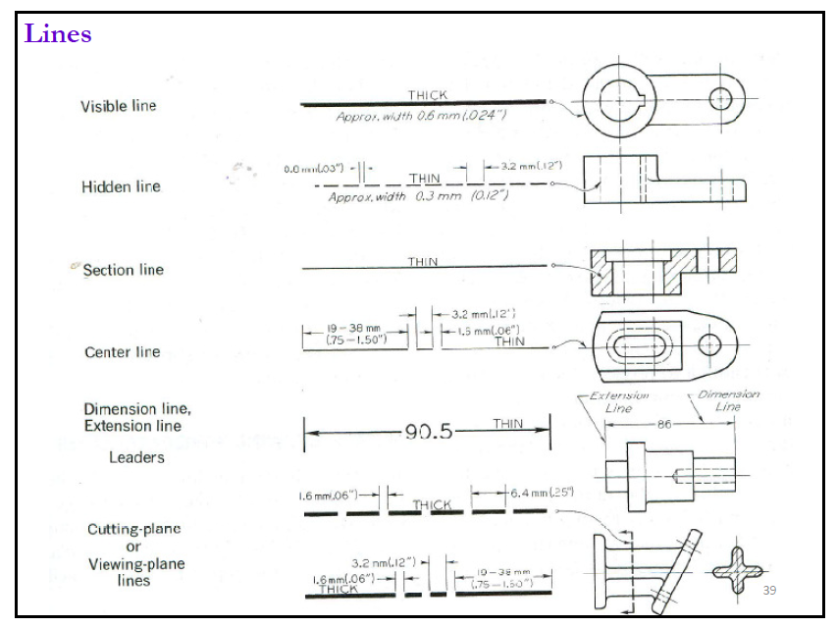

Slide 31
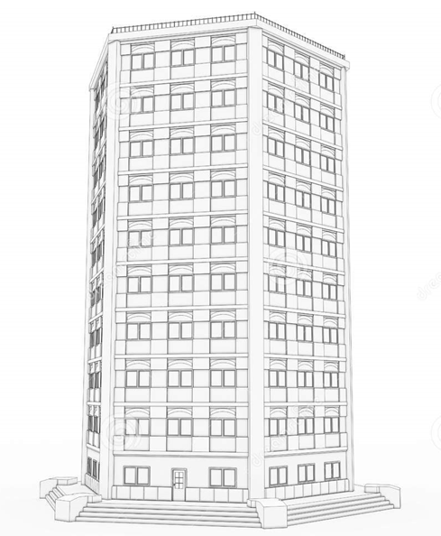
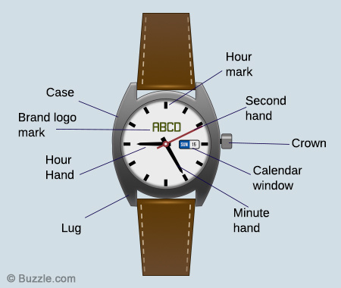
SCALES :
A scale is defined as the ratio of the linear dimensions of the object as represented in a drawing to the actual dimensions of the same.
Some objects like buildings, machines etc are big
some objects are very small like parts used in wrist watches
Some Drawing of above is required to be drawn proportionally reduced or enlarged.
The proportion by which we are enlarging or reducing actual length of the object on drawing is called as scale.

Slide 32
Scale Size :
Full size.
Reduced size.
Enlarged size.

Slide 33
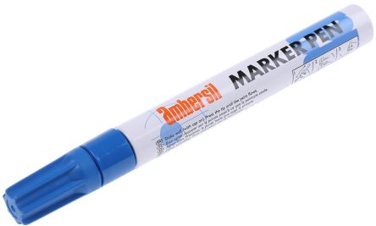
1. Full size
5 cm
5 cm
4 cm
4 cm
The scale in which objects are drawn with actual measurement is called as full size scale.
It is written in ration 1:1

Slide 34
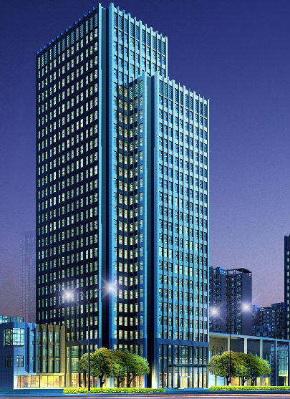
2. Reduced size
5 cm
2.5 cm
4 cm
2 cm
The scale in which objects are drawn with reduced proportion is called as reduced size scale.
It is written in ration 1:2 , 1:5, 1:10, 1:20

Slide 35
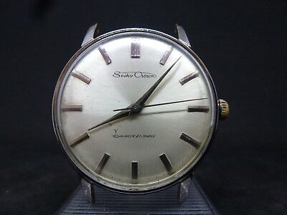
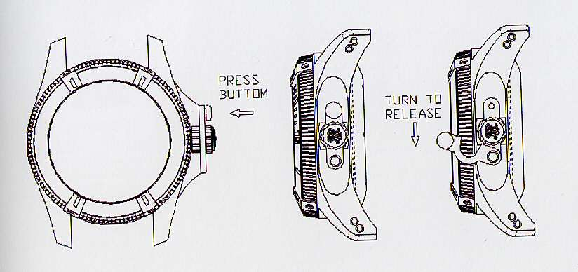
2. Enlarged size
5 cm
2.5 cm
2 cm
4 cm
The scale in which objects are drawn with increased proportion is called as reduced size scale.
It is written in ration 2:1 , 5:1, 10:1, 20:1

Slide 36
Representative Fraction (R.F.)
It is ration of the length of the object on the drawing to the actual length of the object
Length of object on the drawing
R.F.
=
Actual length of object

Slide 37
1. Full size
5 cm
5 cm
4 cm
4 cm
R.F.
=
1
The scale in which objects are drawn with actual measurement is called as full size scale.
It is written in ration 1:1

Slide 38
2. Reduced size
5 cm
2.5 cm
4 cm
2 cm
R.F.
<
1
The scale in which objects are drawn with reduced proportion is called as reduced size scale.
It is written in ration 1:2 , 1:5, 1:10, 1:20

Slide 39
2. Enlarged size
5 cm
2.5 cm
2 cm
4 cm
R.F.
>
1
The scale in which objects are drawn with increased proportion is called as reduced size scale.
It is written in ration 2:1 , 5:1, 10:1, 20:1

Slide 40
Type Of Scale :
Plain Scale.
Diagonal Scale.

Slide 41
Metric Measurements:
1 cm | = | 10 mm
1 dm | = | 10 cm
1 m | = | 10 dm
1 dam | = | 10 m
1 hm | = | 10 dam
1 km | = | 10 hm
1 Yard | = | 3 Feets
1 feet | = | 12 inches
1 inch | = | 2.54 cm
mm | = | Millimeter
cm | = | centimeter
dm | = | decimeter
m | = | meter
dam | = | decameter
hm | = | hectometer
km | = | kilometer
Note : Always calculate in cm

Slide 42
Plain Scale
This scale is used when very small distances are to be accurately measured for example 0.1 mm
When measurements are required up to one decimal place (i.e. 2 unit)
Example : 6.7 , 5.3
6.7 m
6 meter & 7 decimeter
2.3 cm
2 cm & 3 mm
For constructing plain scale we must know:
Its representative fraction i.e. (R.F.) (given or calculate)
Maximum length to be measured (given)
The units to be shown, for example, milimeters and centimeters(given)

Slide 43
Steps for constructing plain scale
Mark Distance
2
10
3
1
0
1
2
3
4
1. Calculate the length of scale.
length of scale = R.F X length to measured
2. Draw two horizontal lines parallel to each other and some distance apart so that they give appearance as a rule. Join the ends by vertical lines.
(1. Length for horizontal parallel lines = length of scale which is calculated previously 2. assume suitable length)
decimeter
meter
PLANE SCALE
R.F. =
3. Divide horizontal lines into required number of equal parts and ( depend upon length to measured or read upto)
4. draw perpendicular lines at these division points.
5. Mark ‘zero’ at the end of first division.
6. sub-divide only first main part to the left of zero into the required number of sub-division according to unit.
Example : 3.2 m means 3 meter and 2 decimeter
1 m = 10 decimeter
Hence we need to divide first part into 10 equal numbers
7. Sub-divisions are numbered to the right, starting from zero.
8. Mark the given distance on scale
9. name of the scale and R.F. should be mentioned below scale

Slide 44
Problem 1 :
Construct a plain scale with R.F. 1:40 to read up to 5 meters in meters and decimeters. Mark 3.4 m on scale
12.5 cm
Given data : R.F. = 1/40 , maximum length = 5 m
2.5 cm
2.5 cm
1. Calculate the length of scale.
3.4 m
length of scale = R.F X length to measured
= 1/40 X 5 m
= 0.125 m
= 0.125 X 100 = 12.5 cm
0
1
2
3
4
9
8
7
6
5
4
3
2
1
10
decimeter
meter
2. Draw two horizontal lines of 12.5 cm parallel to each other and 2 cm distance apart. Join the ends by vertical lines.
PLANE SCALE
R.F. = 1 : 40
3. Divide horizontal lines into required number of equal parts ( depend upon length to measured or read up to)
according to given data for above example maximum length or read up to is 5 m, hence divide parallel lines into 5 equal parts.
Size of individual part = 12.5/5 = 2.5 cm
4. Mark ‘zero’ at the end of first division.
5. Sub-divide only first main part to the left of zero into the required number of sub-division according to unit. In above problem given units are
meter and decimeter and 1 meter = 10 decimeter hence we have to divide first main part into 10 number of equal parts.
Size of individual sub part = 2.5/10 = 0.25 cm
6. Sub-divisions are numbered to the right, starting from zero.
7. Assign units for parts.
8. Mark given distance on scale. For above problem distance = 3.4 m
9. Name of the scale and R.F. should be mentioned below scale

Slide 45
Problem 2 :
Construct a plain scale to show meters when 1 centimeter represents 4 meters and long enough to measure up to 60 meters. Find the R.F. and mark on it a distance of 43 meters.
Given data : R.F. = 1 cm is to 4 meters , maximum length = 60 m
Units : meter and centimeter
43 m
R.F.
=
1 cm
1 cm
1 cm
1
=
=
=
4 m
4 X 100 cm
400 cm
400
0
10
20
30
40
50
1. Calculate the length of scale.
9
8
7
6
5
4
3
2
1
10
length of scale = R.F X length to measured
= 1/400 X 60 m
= 0.15 m
= 0.15 X 100 = 15 cm
meters
meter
PLANE SCALE
R.F. = 1 : 400
2. Draw two horizontal lines of 15 cm parallel to each other and
3 cm distance apart. Join the ends by vertical lines.
3. Divide horizontal lines into required number of equal parts ( depend upon length to measured or read up to)
according to given data for above example maximum length or read up to is 60 m, hence divide parallel lines into 6 equal parts.
Size of individual part = 15/6 = 2.5 cm
4. Sub-divide only first main part to the left of zero into the 10 number of sub-division.

Slide 46
Problem 3 :
Construct a plain scale with R.F. 1:8 to show feet and inches and long enough to measure up to 4 feet, show a distance of 3 feet and 7 inches on your scale.
Given data : R.F. = 1/8 , maximum length = 4 feet
3 feet 7 inches
1. Calculate the length of scale.
0
1
2
3
length of scale = R.F X length to measured
= 1/8 X 4 feet = 1/8 X 4 X 12 inches
= 6 inches
= 6 X 2.54 cm
= 15.24 cm
10
11
9
7
6
2
1
12
8
5
4
3
inches
feet
2. Draw two horizontal lines of 15.24 cm parallel to each other and
3 cm distance apart. Join the ends by vertical lines.
PLANE SCALE
R.F. = 1 : 8
3. Divide horizontal lines into required number of equal parts ( depend upon length to measured or read up to)
according to given data for above example maximum length or read up to is 4 feet, hence divide parallel lines into 4 equal parts.
Size of individual part = 15.2/4 = 3.8 cm
4. Sub-divide only first main part to the left of zero into the 12 number of sub-division. In above problem given units are
feet and inches and 1 feet = 12 inches hence we have to divide first main part into 12 number of equal parts.
Size of individual sub part = 3.8/12 = 0.32 cm

Slide 47
Problem 4 :
Construct a plain scale with R.F. 1:40 and maximum length is 4 meters. Mark 2.7 m on scale where units are in meters and decimeters.
Given data : R.F. = 1/40 , maximum length = 5 m
Problem 5 :
Construct a plain scale with R.F. 1:50000 to show kilometers and hectometers and long enough to measure up to 7 kilometers. Measure a distance of 46 hectometers on your scale.
Given data : R.F. = 1/50000 , maximum length = 7 km

Slide 48
Diagonal Scale
Diagonal scale is used in engineering to read lengths with higher accuracy as it represents into three different unit for example meters, centimeters and millimeters.
When measurements are required up to two decimal place (i.e. 3 unit)
Example : 6.71 , 7.34
7.34 m
7 m & 3 dm & 4 cm
For constructing diagonal scale we must know:
Its representative fraction i.e. (R.F.) (given or calculate)
Maximum length to be measured (given)
The units to be shown, for example, milimeters and centimeters(given)

Slide 49

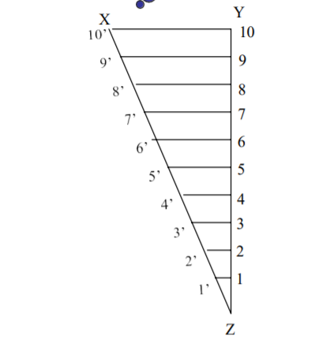
Steps for constructing diagonal scale
Mark Distance ?
Unit 3 ????
2
1. Calculate the length of scale.
10
3
1
0
1
2
3
4
length of scale = R.F X length to measured
2. Draw two horizontal lines parallel to each other and some distance apart so that they give appearance as a rule. Join the ends by vertical lines.
(1. Length for horizontal parallel lines = length of scale which is calculated previously 2. assume suitable length)
3. Divide horizontal lines into required number of equal parts and ( depend upon length to measured or read upto)
Unit 2
Diagonal scale
Unit 1
R.F. =
4. draw perpendicular lines at these division points.
5. Mark ‘zero’ at the end of first division.
6. sub-divide only first main part to the left of zero into the required number of sub-division according to unit.
1 m = 10 decimeter
Hence we need to divide first part into 10 equal numbers
7. Sub-divisions are numbered to the right, starting from zero.
8. Mark the given distance on scale
9. name of the scale and R.F. should be mentioned below scale
After 7 th step we need to perform few different steps to show 3 rd unit
Principle for diagonal scale :

Slide 50
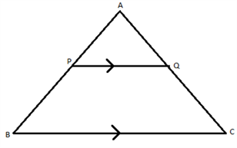
Principle for diagonal scale :
1. Let the XY in figure be a subunit
2. From Y draw a perpendicular YZ to a suitable height. 10
Join XZ. Divide YZ in to 10 equal parts.
X
y
10’
10
9’
9
3. Draw parallel lines to XY from all these divisions and number
them 1’, 2’ and so on.
8’
8
7’
7
4. From geometry we know that similar triangles have their
like sides proportional.
In ΔABC and ΔAPQ, ∠PAQ is common and ∠APQ = ∠ABC (corresponding angles)
⇒ ΔABC ~ ΔAPQ (AA criterion for similar triangles)
⇒ AP/AB = PQ/BC
6’
6
5. Consider two similar triangles XYZ and 7’7Z.
5’
5
7Z
7’7
4’
4
=
YZ
XY
3’
3
x
2
7
XY
7Z = 7 AND YZ = 10
2’
=
7’7
10
1’
1
7
0
x
=
XY
7’7
z
10
7’7
=
0.7 X XY
6. Similarly 1’ – 1 = 0.1 XY , 2’ – 2 = 0.2 XY
Thus, it is very clear that, the sides of small triangles, which are parallel to divided lines, become progressively shorter in length by 0.1 XY.

Slide 51
20 cm
3.68m
10
8
10
9
7
6
5
4
3
2
1
0
1
2
3
9
8
7
6
CENTIMETER
5
4
3
1
0
10
8
9
7
6
5
4
3
2
1
0
METER
DECIMETER
DIAGONAL SCALE
R.F. =
Example : 3.48 m means 3 meter and 6 decimeter AND 8 centimeter

Slide 52
Problem 1 :
Construct a diagonal scale of 1:50 to read meters, decimeters and centimeters to measure upto 5 meters. Show the length of 2 meters, 6 decimeters and 5 centimeters on the scale
Given data : R.F. = 1/50 , maximum length = 5 m and mark 2.65 m
length of scale = R.F X length to measured
= 1/50 X 5 m
= 0.1 m
= 0.1 X 100 = 10 cm
Problem 2 :
On a drawing, a line 10 cm long represents a distance of 5 m. Construct a diagonal scale to read upto 6 m, showing meters ,decimeters and centimeters. Indicate on your scale the length 4.57 m
Given data : R.F. = 10 cm /5 m , maximum length = 6 m and mark 4.57 m
R.F.
=
10 cm
10 cm
10 cm
10
1
length of scale = R.F X length to measured
= 1/50 X 6 m
= 0.02 X 6 m
= 0.12 m = 0.12 X 100 cm = 12 cm
=
=
=
=
5 m
5 X 100 cm
500 cm
500
50
Problem 3 :
Construct a diagonal scale with R.F. = 1/2000000 to measure upto 300 KM. show on the scale the distance of 236 KM
R.F.
=
1
X
300 KM
20,00,000
=
1
30
15 cm
X
300 X 100000 CM
=
=
20,00,000
2

Slide 53
10 cm
2.65m
10
8
4
10
9
7
6
5
4
3
2
1
0
1
2
3
9
8
7
6
CENTIMETER
5
4
3
1
0
10
8
9
7
6
5
4
3
2
1
0
METER
DECIMETER
DIAGONAL SCALE
R.F. = 1:50
Example : 2.65 m means 2 meter and 6 decimeter AND 5 centimeter

Slide 54
Problem 4 :
Construct a diagonal scale with R.F. 1:24 to show yards, feet and inches and long enough to measure up to 4 yards, show a distance of 1 yard and 2 feet and 4 inches on your scale.
Given data : R.F. = 1/24 , maximum length = 4 yards
Convert 4 yards into CM
4 yards X 3 ( 1 feet = 3 yards)
12 feet X 12 ( 1 feet = 12 inches)
144 inches X 2.54 cm ( 1 inch = 2.54 cm)
365.76 cm
Hence 4 yards = 365.76 cm
length of scale = R.F X length to measured
= 1/24 X 365.76
= 15.24 cm

